Slide 1

Vel Tech Rangarajan Dr. Sagunthala R&D Institute of Science and Technology
School of Computing
Department of Computer Science and Engineering
10211CD224 / FULL STACK APPLICATION DEVELOPMENT (JAVA)
PROJECT REVIEW : MILESTONE PROJECT – 1
Date: 24-03-2026
ACADEMICS CAMPUS EVENT AND REGISTRATION PORTAL
SDG: SDG 9-Industry, Innovation and Infrastructure
Presented By:
T.INDRANI-VTU24820-23UCS0902
Courses Handling Faculty:
Dr.S.Hemamalini-Assistant professor

Slide 2
INTRODUCTION
1
Campus events in colleges are often managed manually, leading to confusion, delays, and miscommunication among students and organizers.
This project aims to develop a Campus Event and Registration Portal to simplify event management and participation.
It is important because it reduces paperwork, ensures efficient coordination, and provides a centralized platform for all event-related activities.
The system has real-world relevance as many institutions require digital solutions for managing events smoothly and transparently.
The portal allows users to view upcoming events, register online, and receive updates instantly.
Organizers can create, manage, and track event registrations .
Overall, the system improves accessibility, saves time, and enhances the overall event experience for both students and administrators.
2
3
4
5
6
7
8
9

Slide 3
PROBLEM STATEMENT
1
In many colleges, event management and registration are handled manually or through scattered platforms, leading to inefficiency and confusion. Students often miss important event updates due to lack of a centralized system. Organizers face difficulties in managing registrations, tracking participants, and handling data accurately. Manual processes increase the chances of errors, duplication, and delays. There is no streamlined way to communicate event details and updates in real time. This creates inconvenience for both students and administrators. Therefore, there is a need for a centralized, automated Campus Event and Registration Portal. The system should simplify event management, ensure accurate data handling, and improve overall efficiency.
2
3
4
5
6
7
8
9

Slide 4
OBJECTIVE
1
To design and develop a centralized Campus Event and Registration Portal for managing events and student registrations efficiently.
To implement an automated system that improves data accuracy, real-time updates, and overall event management performance.
To design and develop a centralized Campus Event and Registration Portal .
To implement secure user authentication for students and organizers.
To enable easy event creation, updating, and deletion.
To provide an online registration system for students .
To ensure real-time notifications and updates for users.
To maintain accurate and secure data storage in the database.
To reduce manual work and improve operational efficiency.
To allow organizers to track and manage participants effectively.
To generate reports for analyzing event participation.
To enhance user experience with a simple and user-friendly interface
2
3
4
5
6
7
8
9

Slide 5
PROPOSED SYSTEM
1
The proposed system is a centralized Campus Event and Registration Portal that manages all event-related activities on a single platform.
It allows organizers to easily create, update, and manage events, while students can view event details, register online, and receive instant notifications.
The system stores all data digitally, reducing manual work and paperwork. It effectively solves issues such as miscommunication, data duplication, and delayed updates.
Real-time tracking of registrations helps organizers manage participants efficiently.
Additionally, the portal ensures better accuracy, security, and easy access to information.
Compared to existing manual systems, it is faster, more reliable, and user-friendly.
2
3
4
5
6
7
8
9

Slide 6
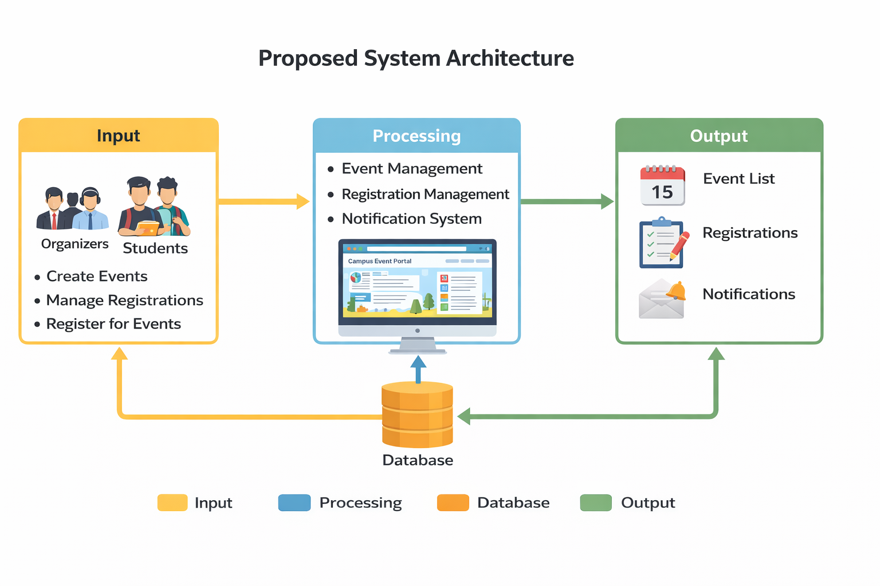
PROPOSED SYSTEM ARCHITECTURE
1
2
3
4
5
6
7
8
9

Slide 7
PROPOSED SYSTEM ARCHITECTURE
Input: The input consists of data provided by users such as organizers and students. Organizers input event details like name, date, venue, and description, while students provide registration details. This is the starting point of the system.
Processing: In this stage, the system processes the input data. It handles event creation, registration management, validation of user details, and sending notifications. It ensures that all operations are performed accurately and efficiently.
Database: The database stores all the information such as event details, student registrations, and user data. It allows secure storage, easy retrieval, and updating of data whenever required.
Output: The output is the result shown to users. It includes event lists, registration confirmations, participant details, and notifications. This helps users access updated and relevant information quickly.
1
2
3
4
5
6
7
8
9

Slide 8
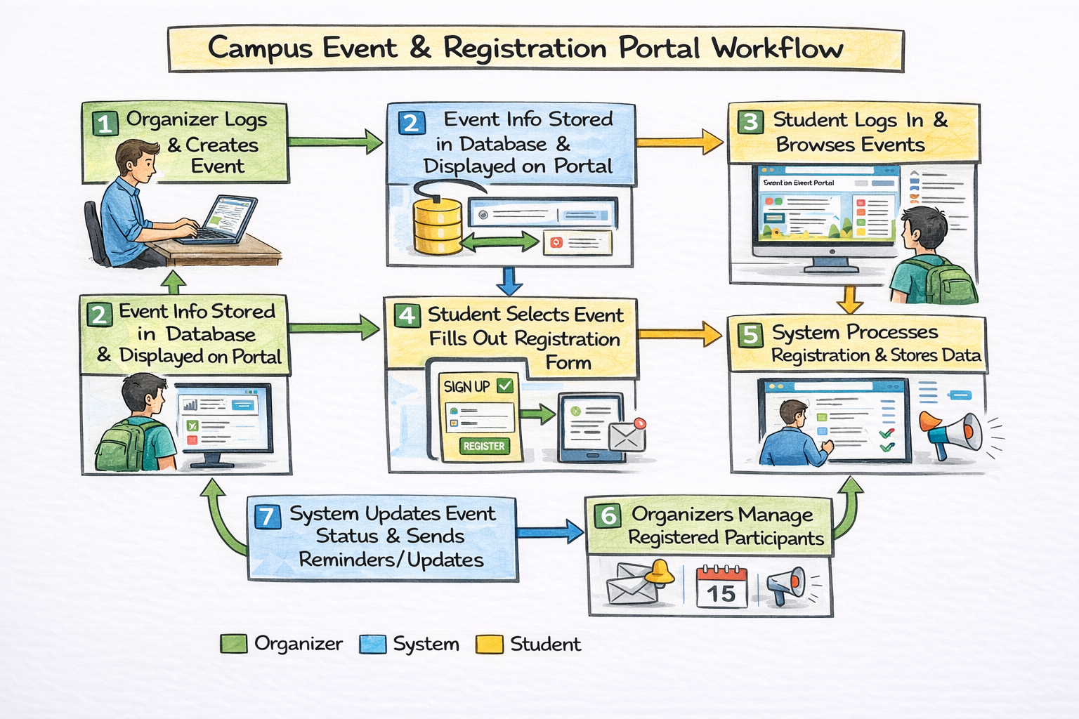
WORKFLOW
1
2
3
4
5
6
7
8
9

Slide 9
TECHNOLOGIES USED
1
Frontend: HTML, CSS, JavaScript.
Backend: Node.js.
Database: MySQL.
Tools: VS Code.
Hardware/Software Requirements:
System with minimum 4GB RAM, 8GB recommended.
Operating System: Windows/Linux/Mac .
Web Browser (Chrome/Edge) .
Internet connection for deployment and access.
2
3
4
5
6
7
8
9

Slide 10
MODULE DESCRIPTION
Module 1: User Management Handles registration and login for both students and organizers. It manages user profiles, authentication, and access control to ensure secure usage of the system.
Module 2: Event Management Allows organizers to create, update, and delete events. It includes event details such as date, venue, description, and participant limits.
Module 3: Registration Management Enables students to register for events online. It manages participant data, confirms registrations, and avoids duplicate entries.
Module 4: Notification System Sends real-time updates, reminders, and confirmations to users about events and registrations.
Module 5: Database Management Stores all data related to users, events, and registrations. Ensures data consistency, security, and quick retrieval.
Module 6: Reporting & Analytics Generates reports on event participation, registrations, and trends. Helps organizers make better decisions and analyze event success.
1
2
3
4
5
6
7
8
9

Slide 11
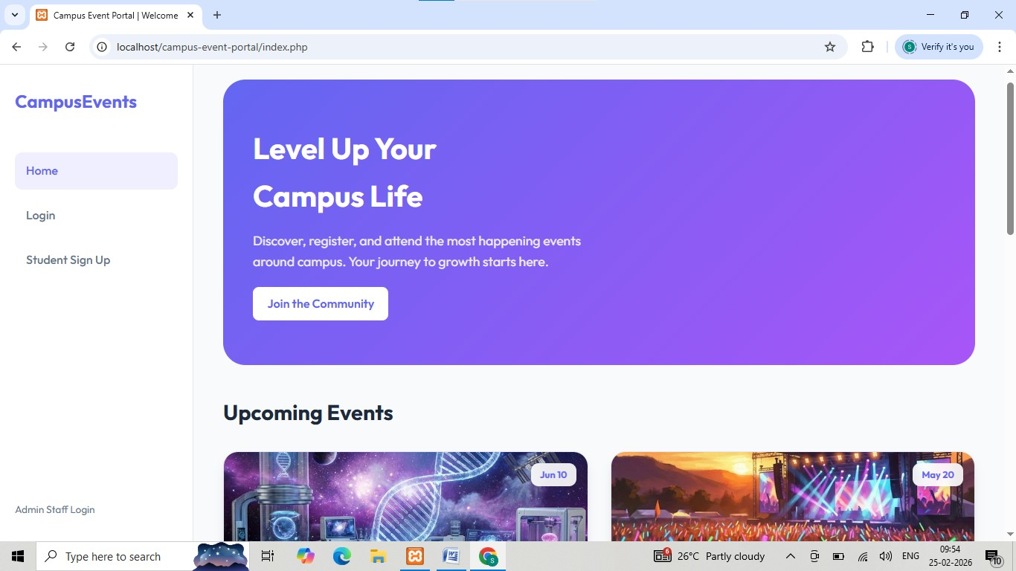
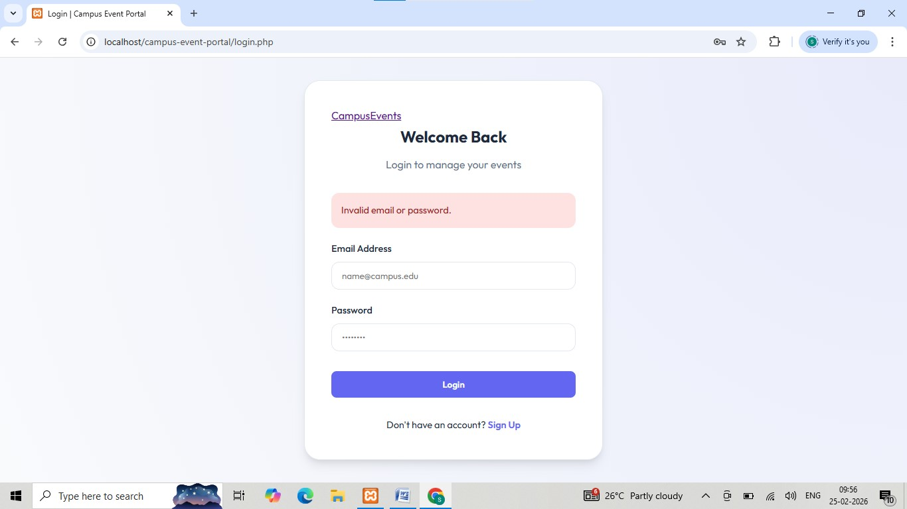
IMPLEMENTATION SCREENSHOTS
1
2
3
4
5
6
7
8
9
Fig 1: Home page
Fig 2: Student login page with validation

Slide 12
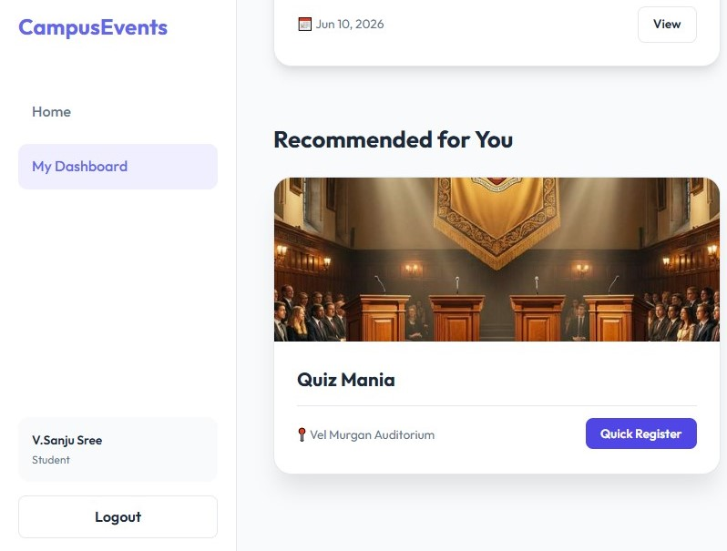
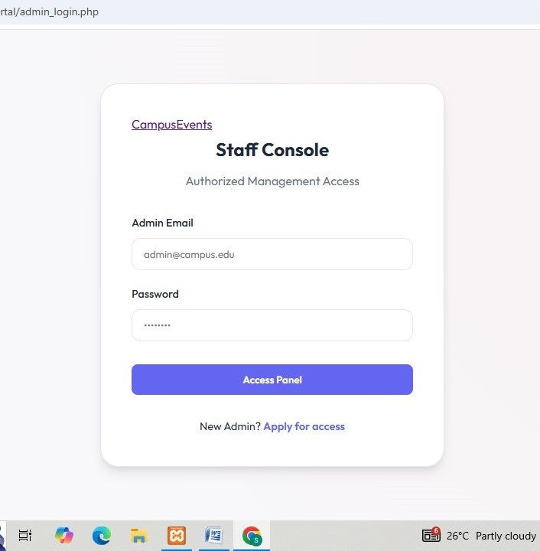
IMPLEMENTATION SCREENSHOTS
1
2
3
4
5
6
7
8(A)
9
Fig 3: showing upcoming events ,and able to register
by clicking Quick Register button
Fig 4: Admin login page

Slide 13
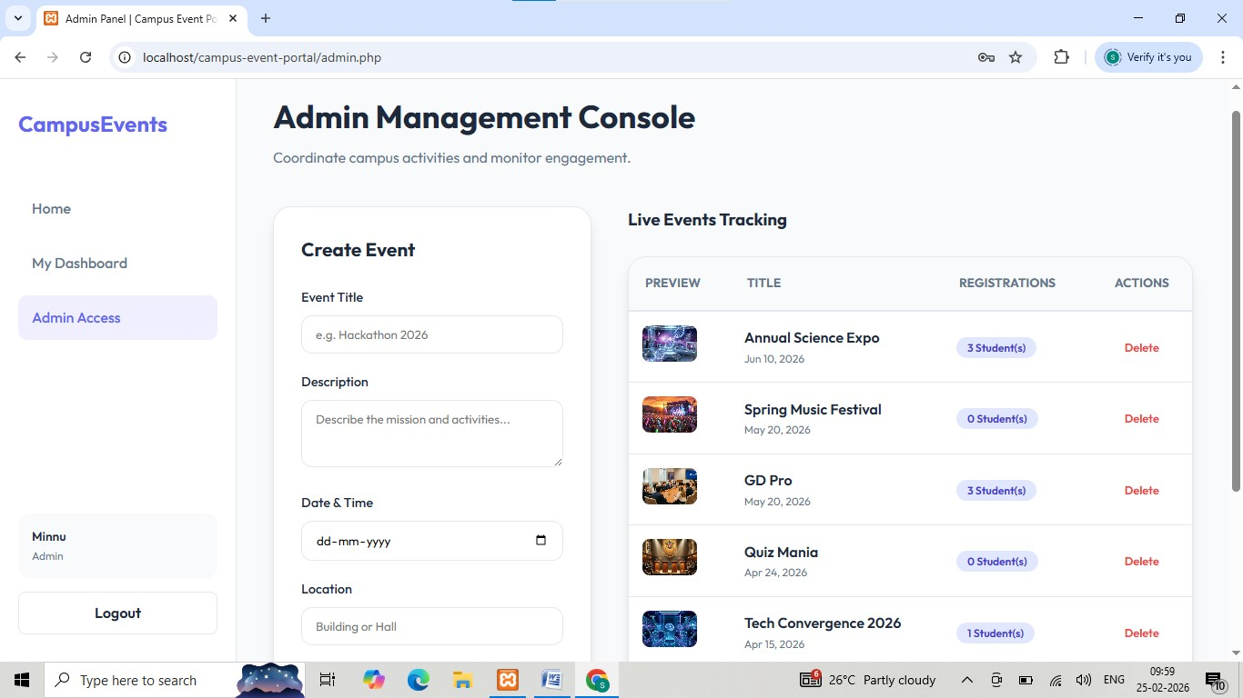
IMPLEMENTATION SCREENSHOTS
1
2
3
4
5
6
7
8(B)
9
Fig 5: Admin dashboard, and also can create events .

Slide 14
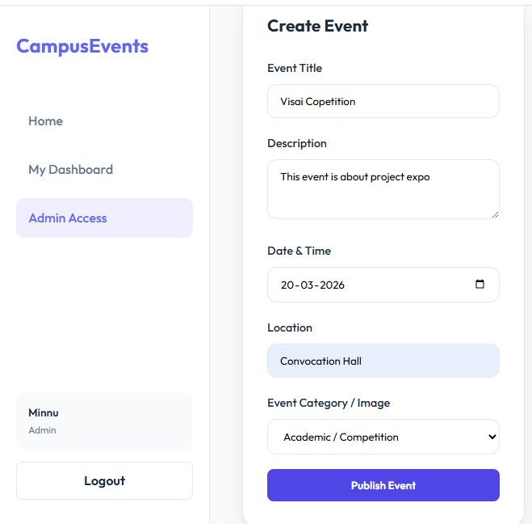
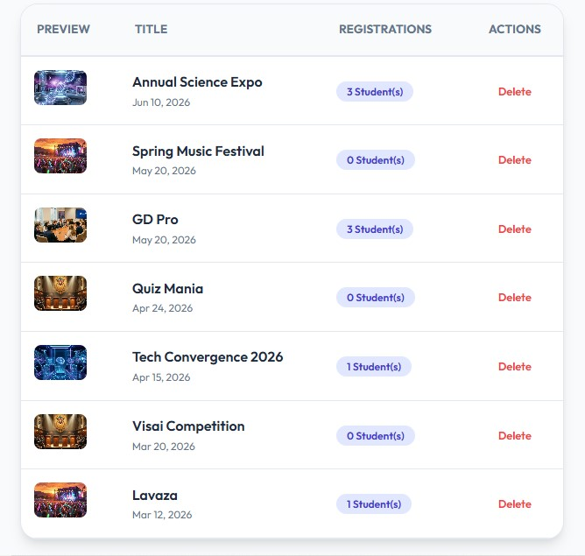
IMPLEMENTATION SCREENSHOTS
1
2
3
4
5
6
7
8(C)
9
Fig 6: Admin can add the event by using
the button “Publish Event” as shown .
Fig 7: Admin can delete the event by delete button as shown.

Slide 15
ADVANTAGES & LIMITATIONS
1
Advantages:
Reduces manual work and paperwork through automation
Provides a centralized platform for all campus events
Enables real-time updates and notifications
Improves accuracy and reduces data duplication
Easy access for students and organizers anytime
Efficient management and tracking of registrations
Limitations:
Requires internet connectivity for access
Initial development and setup cost
Dependence on system maintenance and updates
Possible security risks if not properly managed
Users may need basic technical knowledge to operate the system
2
3
4
5
6
7
8
9

Slide 16
Thank you

